Slide 1

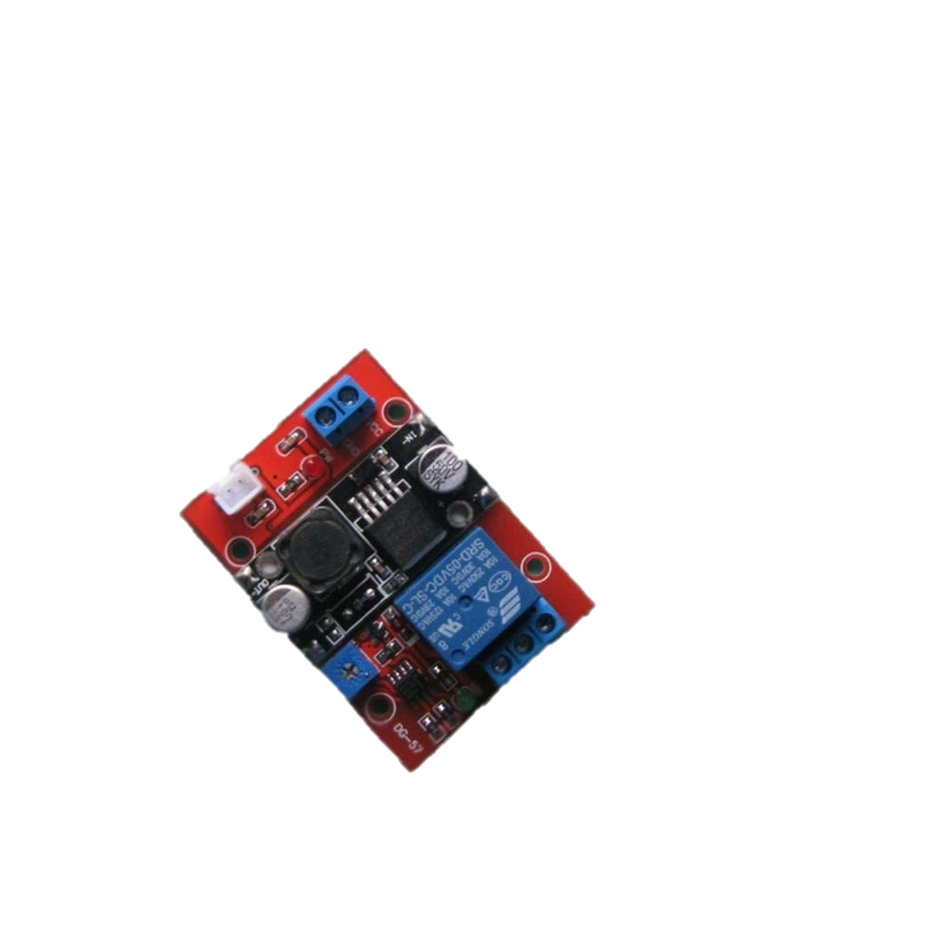
Project Stage-I (PW-EE 781) Project Title :- Over Heating Load cut off system
HALDIA INSTITUTE OF TECHNOLOGY
P.O. HIT, HIT COLLEGE ROAD , KHUDIRAAM NAGAR , HALDIA WEST BENGAL
Presented By :-
AKASH KUMAR (01619008)
RAHUL KUMAR (01619067)
ANIL SINGH (01619014)
VISHAL ANURAG (01619122)
ADITYA SHIVAM (01619005)
Under the Supervision of :
Mr. VIKAS RANJAN (Associate Professor) &
Mr. S. PRAMANIK (Associate professor)

Slide 2
CONTENTS
PROJECT OBJECTIVE
ABSTRACT
INTRODUCTION
MAIN HARDWARE COMPONENTS
CIRCUIT DIAGRAM
PROJECT APPLICATIONS
PLAN OF WORK
LITERATURE SURVEY
FUTURE SCOPE
CONCLUSION
REFERENCES

Slide 3
ACKNOWLEDGEMENT
The success and final outcome of this project required a lot of guidance and assistance from many people and I am extremely fortunate to have there support all along the completion of this project work. Whatever, I have done is only due to such guidance and assistance and I would never forget to thank them.
I owe my profound gratitude to my project guide MR. VIKASH RANJAN &
MR. S. PRAMANIK who has the attitude and substance of the genius; he continuously and convincingly conveyed a spirit od adventure in regard to research, and an excitement in regard to teaching. he took keen interest in this project and guided us all along, till the completion of this project work by providing all the necessary information for developing a good system.

Slide 4
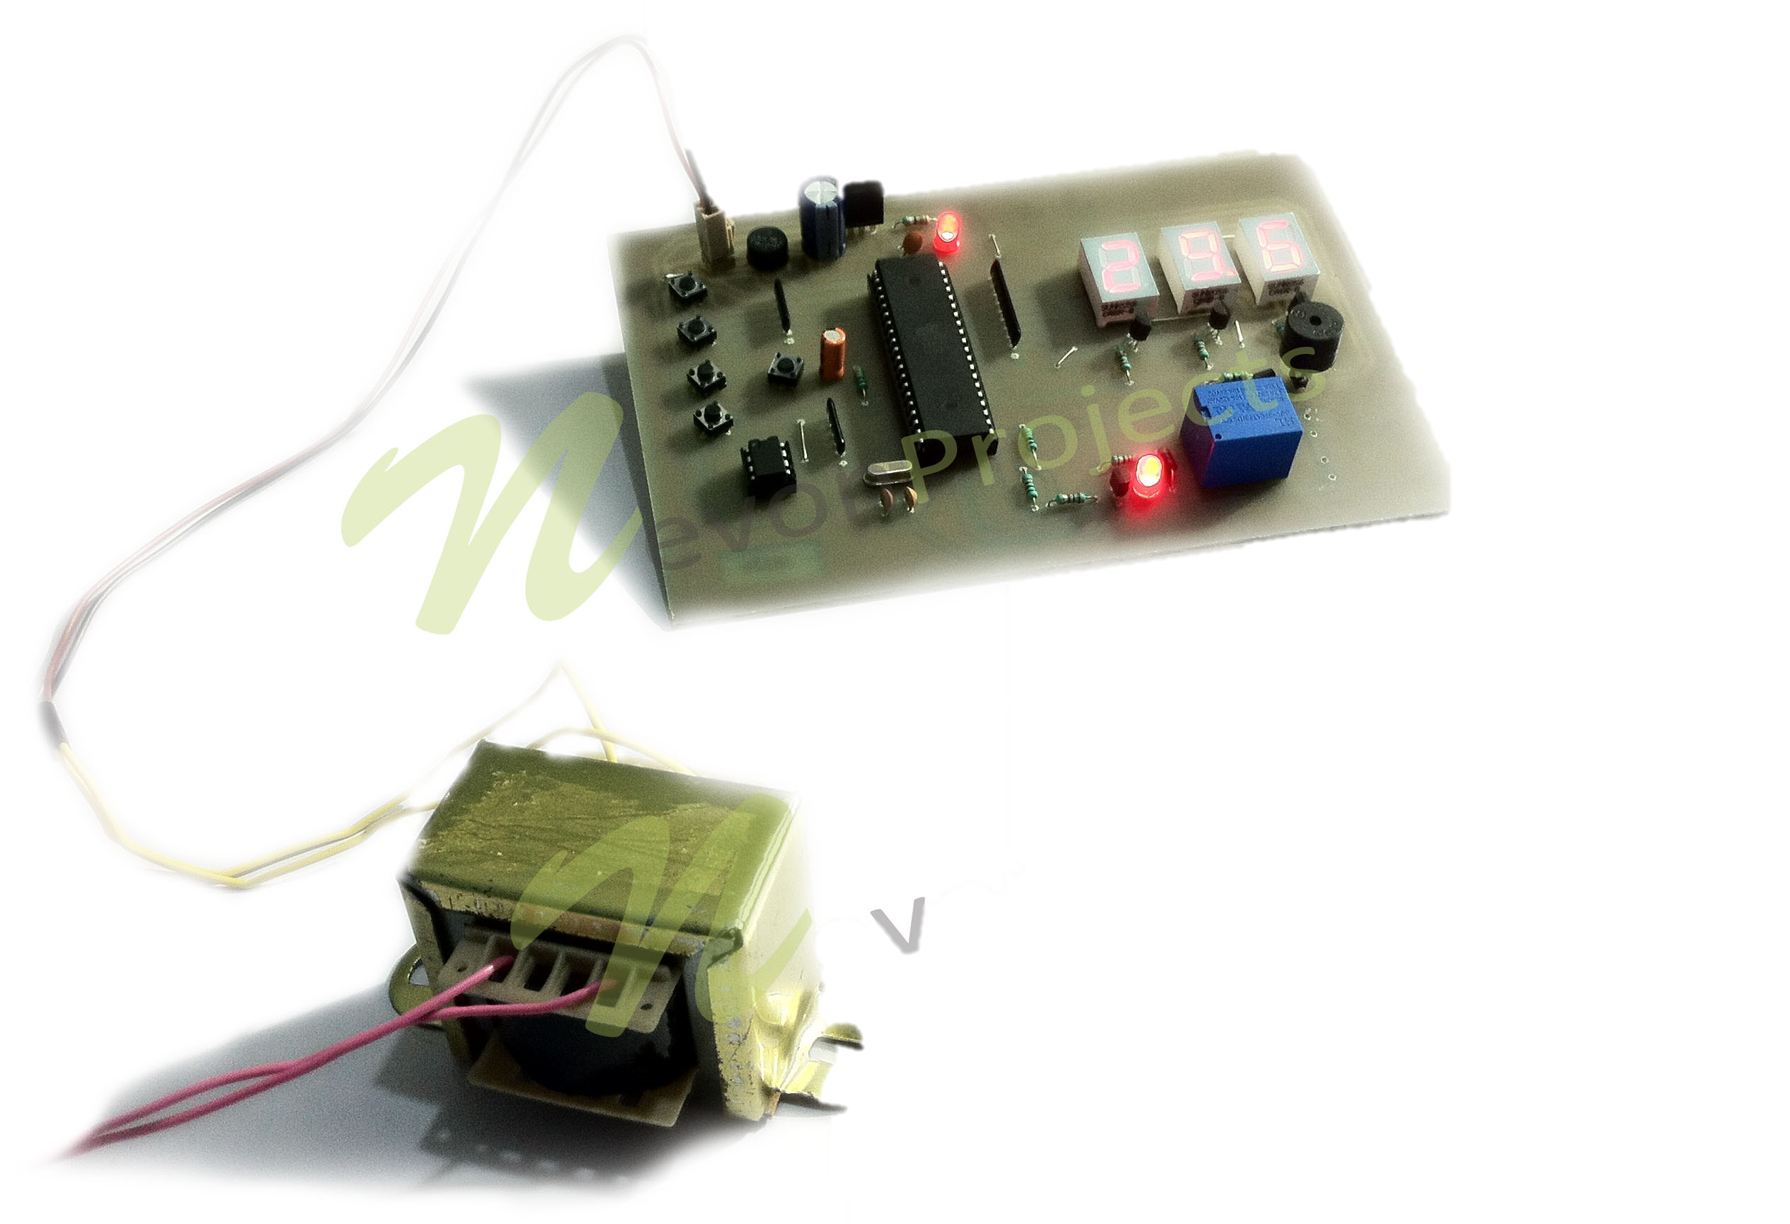
Objective
This project have important aim of many types of Electrical and Engine operated Machine prevent against Over heating Damages
And increase its life-time.

Slide 5
ABSTRACT:
A simple heat detector circuit that can be used as a heat sensor. In this heat detector circuit, a potential divider circuit is formed with a series connection of thermistor and 100 Ohms resistance. If (Negative temperature Coefficient)N.T.C type transistor is used, then the resistance of thermistor decreases after heating. Thus, more current flows through the potential divider circuit formed by thermistor and 100ohms resistances. Hence, more voltage appears at the junction of thermistor and resistor. A Zener diode is used to maintain emitter voltage at 4.7 volts, which can be used comparatively. If the base voltage is greater than the emitter voltage, then the transistor starts conduction. This is because as the transistor gets more than 4.7V base Voltage and a buzzer are connected to complete the heat detector circuit which is used for producing sound.

Slide 6
Introduction
This project operate on temperature sensor LM35 op-amp IC Lm358.
The project working demonstrate like overheating against machine results in automatic stop or alert with electronic siren.
When electronic machine will be under safe operating temperature, then automatically machine start.
The project have types of machine electronics generator and types of engine 12V DC motor.
This project work on 12V DC and battery charging for auxiliary battery supported.

Slide 7
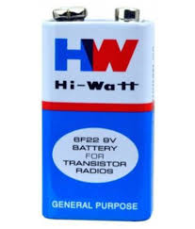
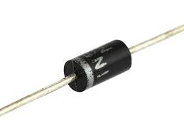
Components specification:
1) Battery (9v Dc supply)
2) Rectifier diode (4007) 24v 1 ampere capacity

Slide 8
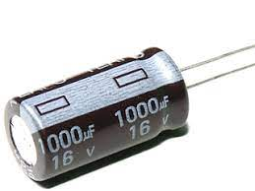
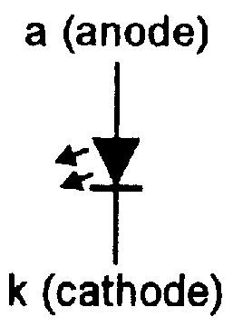
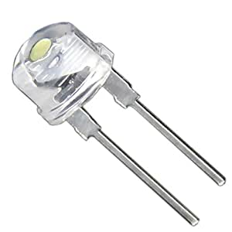
3) capacitor (1000MF/16V)
4) Dc led bulb(10MM) 300 Meilli ampere

Slide 9
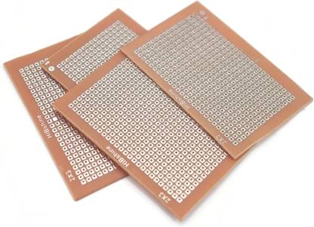
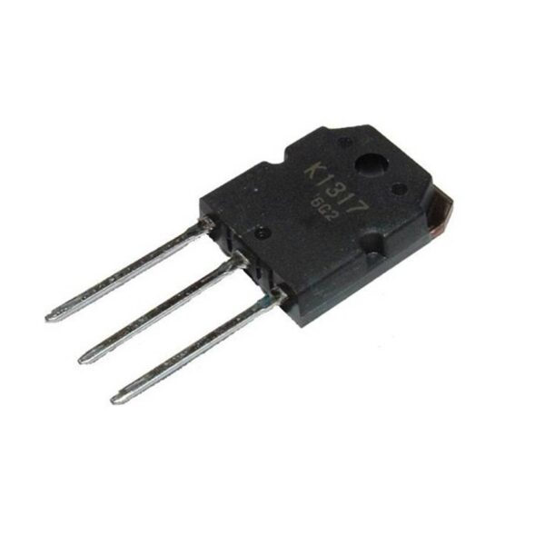
5) PCB circuit board
6) Mosfet IRFZ44

Slide 10
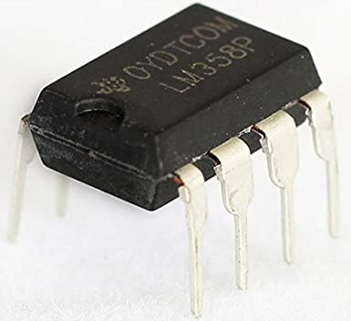
7). These devices consist of two independent, high-gain frequency compensated operational amplifiers designed to operate from a single supply or split supply over a wide range of voltages.
8). The LM35 series are precision integrated-circuit temperature devices with an output voltage linearly-proportional to the Centigrade temperature. The LM35 device has an advantage over linear temperature sensors calibrated in Kelvin, as the user is not required to subtract a large constant voltage from the output to obtain convenient Centigrade scaling. The LM35 device does not require any external calibration or trimming to provide typical accuracies of plus/minus 1/4 degrees C at room temperature and plus/minus 3/4 degrees C over a full -55°C to 150°C temperature range. Lower cost is assured by trimming and calibration at the wafer level. The low-output impedance, linear output, and precise inherent calibration of the LM35 device makes control the circuit.

Slide 11
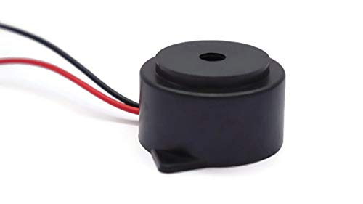
9) Buzzer
A buzzer or beeper is an audio signaling device. which may be mechanical, electromechanical, or piezoelectric. Typical uses of buzzers and beepers include alarm devices, timers, and confirmation of user input such as a mouse click or keystroke.

Slide 12
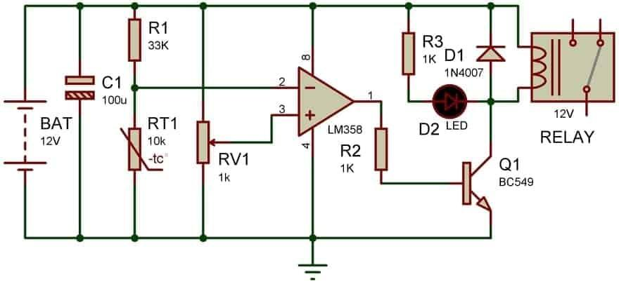
Circuit Diagram

Slide 13
ADVANTAGES:
Very easy to implement.
High reliability.
Speed operation
Dis- Advantages:
Properly battery charging required.
Regular sensor clean.

Slide 14
APPLICATION:
1. Domestic Appliances.
2. Industrial Machinery.
3. Generator.
4. AC-DC motor.
PCs
Microwave ovens
Industrial Machinary

Slide 15
METHODOLOGY AND PLAN OF WORK:
This project work on op amp inverting and non-inverting difference Voltage current against output 0 or 1 like one and off this project in op-Amp IC use LM358 and type of sensor use LM35 temperature sensor this sensor Voltage flow high against heat effect and normally condition in Voltage level low. According to temperature sensor Voltage level by IC output switching on or off this IC output pin connect with NPN MosFET transistor. And transistor Based Voltage pin This NPN transistor is switching driver for electronics siren this transistor BC547 NPN type this project work on 12V Battery and non-technical clear in circuit diagram.

Slide 16
TO BE CONTINUED..
Today we are building a simple yet very useful circuit using Temperature Sensor LM35. In this circuit, we are going to control the LEDs according to temperature around. If temperature goes beyond a particular level (50Degree in this circuit) then Red LED will glow automatically, otherwise yellow LED remains on below that particular temperature. This threshold temperature value can be set by adjusting the Variable resistor in the circuit, according to requirement.

Slide 17
LITERATURE SURVEY:
Prof. Mukesh Tiwari, Mr. Manish Shrivastava (2013) was published to develop this project is from an machine overheat detection with alert blog known as “heat detector”. The article talks about the need of such a project to be and how it would ease the existing industries area that is in place today. In the traditional system, several people are required to monitor a machine lot so as to assess the number of free slots and match it with the capacity of a working machine. If this system is replaced with an automated indicator the number of People employed would reduce. The article talks about this scenario. The need for each component is also elucidated. The heat detector is the heart of this project. The board is controlled using a program that is written on it. The program assessed the number of switches presses where each switch corresponds to a slot and subtracts it from the capacity or the total number of slots present. The literature also describes the common anode display used to display the number of free slots calculated using the program.

Slide 18
Research into the current trend toward the development of fire detection algorithms and multi-sensor, multi-criteria fire detectors is prevalent in the literature in the last decade [e.g.1996; Milke and McAvoy, 1997; Rose-Pehrsson, et al., 2000; Wong, et al., 2000].However, advancement in the research behind predicting the response of common spot-type ionization and photoelectric detectors has been minimal. More fundamental approaches exist to model the detectors, though these methods have not been advanced sufficiently to prove practically useful for modeling smoke detectors.

Slide 19
Future Scope:
The features and functions discussed will bring new value to the service and to industry owners. Benefits to the overheat detection service relate to the provision of real time information that enhances operational effectiveness and safety. Benefits to the owner involve enhanced reliability and reduced costs of maintaining safety systems. The industry fire alarm system is the best candidate for the performance of these functions since they have the needed infrastructure, reliability, and survivability needed to accomplish the objectives. The studies can be used in future to identify the main volatiles that are responsible for causing the sensor response variations. Using this knowledge gained from the analysis and studies one can customize the sensor array towards these main volatiles.

Slide 20
Conclusion:
This project completely machine load cut off by over temperature apply on sensor and when load cut off than electronics buzzer on and temperature sensor going normal temperature than machine automatic start.

Slide 21
References:
www.wikipedia.org
2.http://ijettjournal.org
3. http://myprojectcircuits.com/topics/machineoverheat.html
4. http://www.electroschematics.com/699/overheat-detectoralarm-switch/
5. www.newportelec.com/diodes.html
6. https://solarbotics.com/product/17185/
7. http://nevonprojects.com

Slide 22


